Slide 1


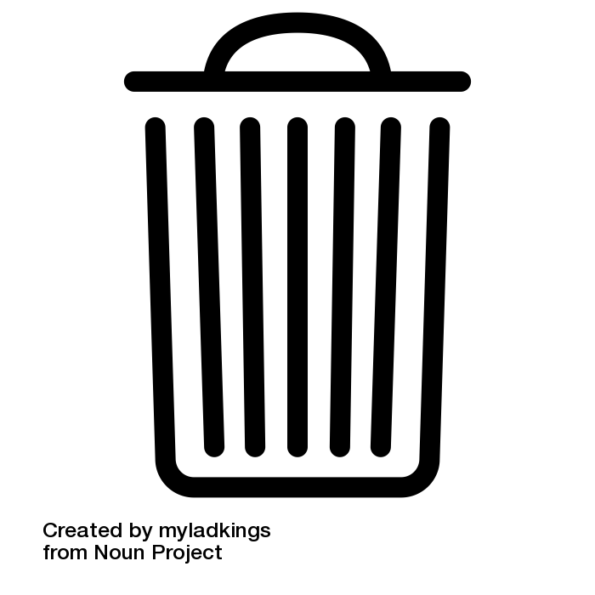
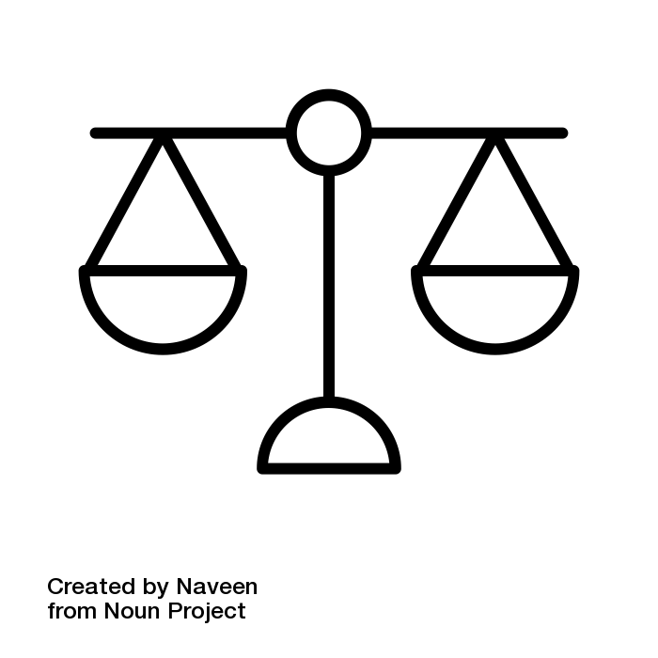

Introduction
Worldwide, one-third of food for human consumption is wasted. Every year, France wastes nearly 10 million tonnes of food, which represents 317 kg per second. Of these 10 million tons, more than 1.2 is food which is still consumable, and that represents approximately 20 kg per French and per year. Restaurants are responsible for 14% of food waste in France (2016).
The causes of food waste are numerous and linked in particular to the loss of monetary and symbolic value of food compared to other expenses and activities, the evolution of society and family organization, new ways of living. fuel, change of pace of life ... And the consequences are heavy on the environmental, economic or social level.
The reduction of waste has become an international and collective issue, which comes in three aspects. Firstly, the environmental aspect, because on a global scale, food waste emits as much greenhouse gas emissions as a country whose activity level would be in 3rd position just after that of China and the USA because food requires the energy needed to produce, package, transport products. It is also a waste of natural resources, including water.
The waste of food is inevitably a waste of money and it is expensive: between 12 and 20 billion euros per year in France, which is the equivalent of 159 euros per person for households alone. Ethically and socially, the waste of food is a growing problem in a current social context where it is estimated that one in ten people in France are struggling to feed themselves.
It is therefore a question of meeting a collective challenge which has two objectives: to manage waste and to avoid waste. This goal will be achieved through the implementation of a public policy.
To find a coherent policy, we first analyzed the strengths and weaknesses of implementing a potential public policy on waste and waste management in order to have the most effective policy possible.
Waste in France
10 million tons of food waste per year
317 kg per second
Restaurants are responsible for 14% of food waste

Slide 2

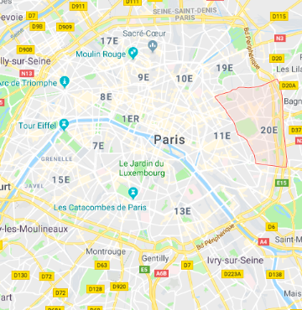


CHOICE OF LOCATION
Concerning the location of the project’s implementation, we decided to experiment it in Paris. We choose a specific district in Paris : the 20ème arrondissement. The benfit of choosing it is that it’s a small district ( 5.98 km2) and possesses a good number of inhabitants ( 198 042 inhabitants). As the population brings together several socio-economic profiles, it allows us to analyse the repercussions of politics from various angles.
198 042 inhabitants
5.98 km2

Slide 3
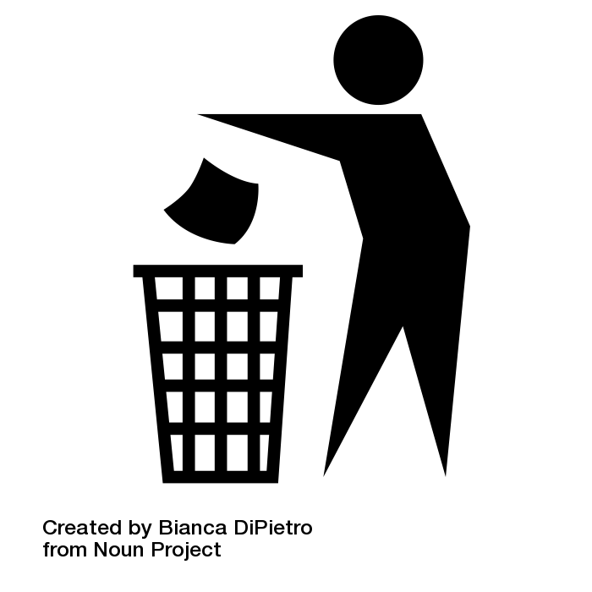
WHY THIS PROJECT ?
OBJECTIVE 1: MANAGING WASTE
OBJECTIVE 2: MEET WASTE TREATMENT NEEDS IN A FAR-EXPANDING AREA
Just after waste reduction and prevention, waste sorting at the source is a very important step in guiding them in an appropriate sector, in a circular economy approach. However, it requires adequate storage space, adapted sorting centers, and above all awareness and investment of the population.As a producer of waste, the household must comply with the instructions given to them by the community in charge of collecting household waste from their municipality of residence (public waste management service). Most of these communities distribute sorting guides for their residents’ use. The sorting instructions can vary locally, the will of all the actors involved is to converge them by 2025 so that the sorting of waste is easier.The sorting of daily waste concerns in particular packaging and paper, but also and more and more bio-waste (kitchen waste, leftover food and garden waste). We will focus on packaging and paper. Concerning plastic packaging, the goal is to extend to all households the possibility of sorting for recycling all plastic packaging (including pots, trays, blisters) whereas previously only bottles and flasks (containers with flasks) had to be sorted.
In the context of developments of Le Grand Paris, the north-east metropolitan quarter is set to undergo profound changes, which will shape the territory for several decades, and must be taken into account: increasing urbanization, demographic growth, economic attractiveness, projects of amenities, etc. For the time being, there is no capacity for treating garbage in this territory, as many tons of residual garbage in this area are still buried. It will therefore be necessary to provide an answer to the territories' need for waste treatment.

Slide 4
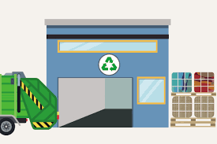
SORTING CENTRE

Slide 5


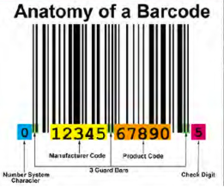
How will the sorting center work ?
Technology used : Barcode Printing
Sorting centre is basically a location where something is organised category wise and then processed. This is exactly what we aim to do in our model of the sorting centre for waste disposal. The model we are proposing for Paris is based upon and draws links from the Waste Sorting Centre in Marlborough, New Zealand.
So the Paris model would have arrondissement wise sorting centres i.e 20 sorting centres covering the region, one for every arrondissement. Pickups of waste will be scheduled twice a week initially but could be subject to change. Since this is a test stage, the number of pickups scheduled per week could be varied according to need and the population density of the area (number of people per unit area). This would mean that areas with higher population density could require more frequent pickups due to the more amount of people living there. Pickups will be scheduled Rue/Boulevard wise and a pickup schedule will be put into place. Each family/household would be assigned a barcode. This barcode will be unique to that particular family. The same barcode will also be present on the garbage disposal bags that the family will provide for the pickup.
What is a barcode?
“A barcode is an assembly of parallel vertical lines of different width and spaces, allowing the reading of information with a simple optical reader. This way, a barcode allows a quick recognition of a product in a unique, global, and non-ambiguous way at any point of the logistical chain, allowing it to be registered, accounted for, and inquired about its characteristics.”
Barcode printing on disposal bags is something that is growing in popularity. It basically involves printing of barcodes on surfaces like plastic for help with identification. There are many real life examples as well as some companies that provide these services.
We can look to partner with one of these companies and sync their production schedules with our pickup schedules where in the second pick up for the week will provide the families with a new set of plastic bags and the plastic used to make these bags can be provided from the previous bags which will be recycled at the sorting centre. This way we ensure that the whole logistical chain is sustainable, renewable and reusable.

Slide 6
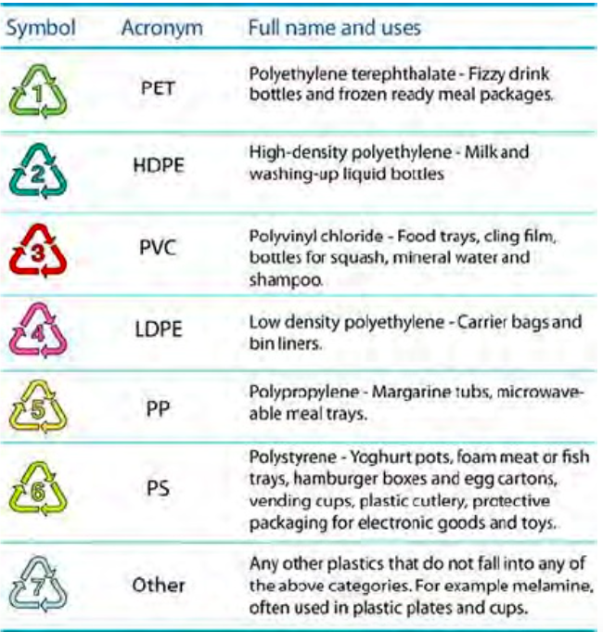
The sorting centre will categorise waste into 4 major divisions:
Paper/Cardboard
Plastic
Glass/Metal
Other
Thus each family will sort out their waste in these 4 categories and each of these categories will have a different colored plastic bag with the family’s barcode so that when the waste reaches the sorting centre they know how well the family has sorted the waste into the 4 categories.
Once the waste is received at the sorting centre, it will be inspected and perfectly categorised. The aim of this process will be to ensure that there is optimum allocation of waste via category and at the same determine the extent to which how well each family has categorised their waste before sending it to the centre.
The sorting centre will thus be divided into 4 parts with each part containing a conveyor belt where the waste will be disposed and then the inspection will be carried out. These conveyor belts will have the barcode triple scanner (as used by Lidl) linked to them to scan the waste bags and judge the quality of allocation.
The barcodes of the bag with improper allocation will be noted and an email/message sent to them regarding their improper allocation. Repeat offenders to be penalised. While on the other hand people with perfect allocation will be given incentives.

Slide 7

Technology used: Lidl’s Triple Scanner
Apart from this, people will also be given the option of driving down to the sorting centre and dispose of items they are not using like e-waste or old refrigerators or other appliances and anything else that is of no use to them but can be recycled or put to better use. Additional incentives will be awarded for the same.
The European Union has set a target of recycling 50% of the household waste generated by 2020. The sorting centres can be Paris and France’s way to contribute to the same as sorting centres will allow us to use waste productively i.e reuse and recycle (increase the percentage of waste being reused or recycled) rather than simply dumping in landfills.
There is a need to automate the sorting process not only for economic and efficiency reasons, but also in a social dimension. As testified by François Haslé. working in a sorting center is harshest and depreciating. This type of labor is similar to assembly-line methods in line with the 20th century. He even compares it to Germinal.
Unfortunately, even with such advanced technologies, we will still need human employees, but very few, just to supervise the fully-automated process. Thus, they will be posted at the beginning and at the end of the chain. We will see why, progressively.
Cost estimation
Such a technological structure would cost around 30 million euros, according to the model of PARIS XV.
PARIS XV model presented by Syctom
It is a sorting center at the cutting edge of technology, designed to recycle the garbage of five arrondissements. Thus, the total price for Paris city would be around 120 million euros, which seems to be huge but only represents 2.3% of the annual city’s budget (of 5,159 billion euros in 2017), knowing that this investment would be spread over several years.

Slide 8
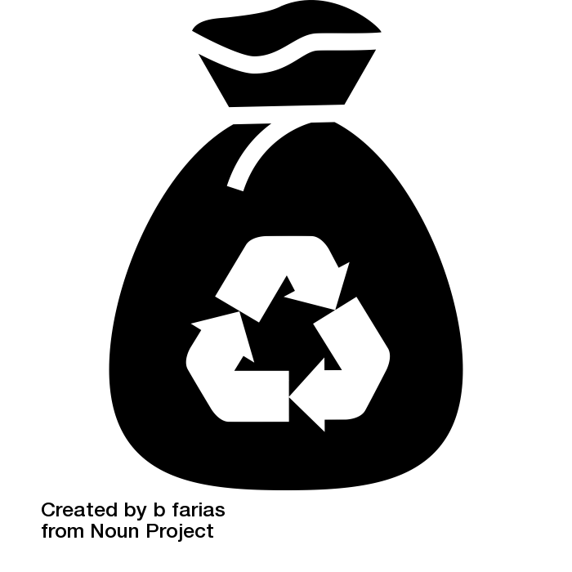
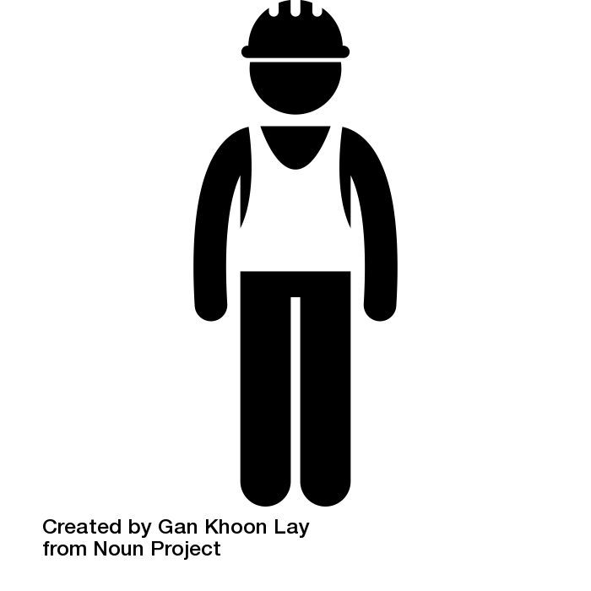
Bags’ identification: the triple scan
For the first step, which consists in identifying the origin of the garbage bag, we may use “triple scan” technology. This innovation has been developed by Lidl (it was at first dedicated to product’s barcodes detection in the large-scale distribution). But as its functioning is quite simple, we could easily adapt it to the garbage bags. Obviously, the only thing in common with a supermarket scanner would be the working principle. For the machine, we would use an industrial scan, whose cost is negligible on the factory scale (only few thousands of euros). It only requires two things: barcodes on several surfaces of the packaging, and three scanners (one horizontal downside, and two vertical on the sides). Thus, when the garbage bags are dropped one-by-one on the conveyor belt, one of the three scans will surely and automatically scan one of the multiple barcodes, which means it won’t need any human intervention in the process of identifying the origin of the garbage bag.
Human intervention
Then, the larger part of the sorting is also automated. We just need few employees at this step, to check if some non-recyclable objects slipped into the wrong bags. If it is the case, they will push a button next to the conveyor chain. It will automatically send a message to the concerned household.
The need for workforce will only depend on the quality of individual sorting, and thus on the public awareness campaigns. For the rest, the sorting will be insured by a complex combination of new technologies. It is very innovative compared to the current sorting centers which employs dozens of people for this arduous and exhausting work.
ALTRIANE sorting center (Communauté d'Agglomération de La Rochelle) which employes 25 people.
It may sounds a disproportionate work to do, but in fact, it is the case at the moment. Now, let’s talk about the technology itself.

Slide 9
low separation: the ballistic separator
The three different flows (paper and cardboards ; plastics ; and aluminium or metal cans) would be separated by ballistic separators. A ballistic separator is a rotor that uses impellers to fling the different materials in the air. The materials are projected at different distance, depending on their weights. But having those three flows is not enough. Afterwards, three specific technologies will be used to sort metals, plastics and papers.
Metal sorting; the magnetic separator
For the metal, we would use a magnetic separator. This system consists in a rotating magnetic drum, placed above the conveyor belt. It produces a magnetic field which attracts the ferrous particles.
This step is crucial not only for obvious ecological reasons. It also prevents the employees from injuries (such as François Haslé’s “multiple scratches”). And it protects the material, as it takes off the ferrous particles larger than 3 mm.
Plastic sorting: optical separator
The optical separator is without doubt the most complex technology on this chain[6], as it uses infrared spectrometry. Indeed, all the materials have a different specter, which can be used to identify them by comparing to a data base. Again, this scanner is placed above the conveyor chain. It analyses wastes’ specters within the space of few milliseconds, thanks to a processor. Once the material has been detected, the wastes are blown with compressed air canons towards different gutters.
But one optical separator is not enough, as we can sort the materials depending on different criteria, such as fibrous material/flat material, hollow bodies/full bodies, polypropylene/polystyrene/others, etc. That is why we usually combine seven different optical separators, “in a cascade”, to refine the sort at each step.
Waste packaging: the baling press
Conversely, this system is very simple but necessary at the end of the process. It compresses the materials to make bales, which eases the storage and handling.

Slide 10
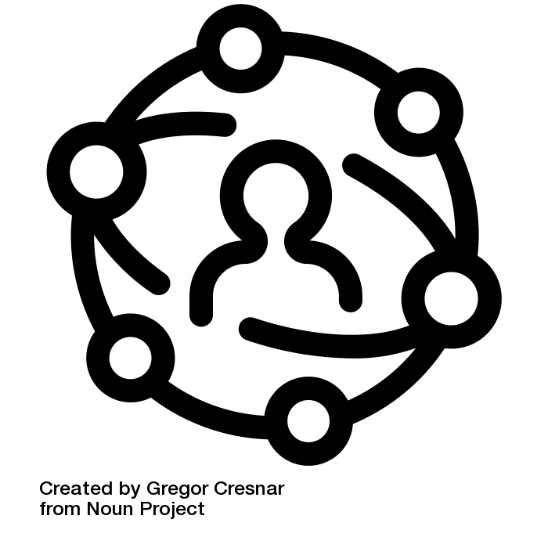
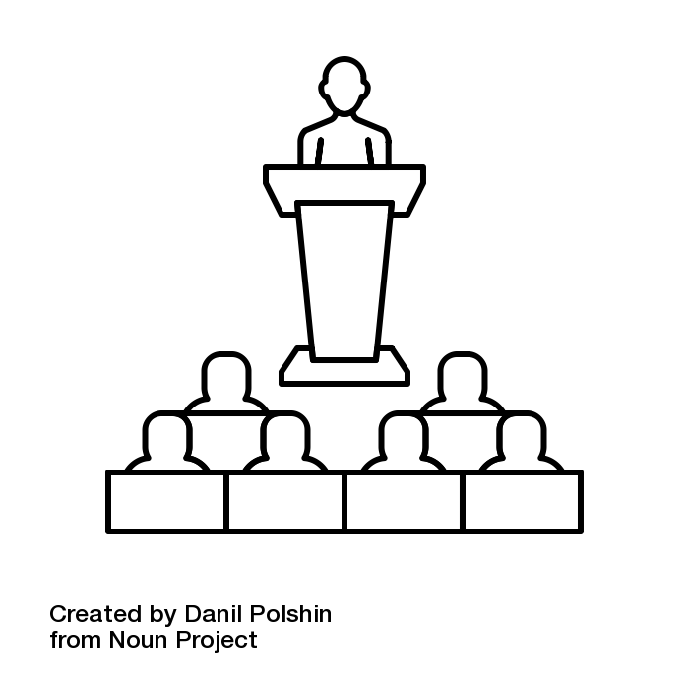



COMMUNICATION STRATEGY
Our wish is to help people to recycle their waste more intuitively and easily. And so, encourage recycling for the preservation of our environment. But the success of our project must absolutely involve an effective and detailed communication. Without communication to inform citizens of the functioning of selective sorting with the recyclable bags and the application, the project will not work. Cooperation and participation of citizen is therefore essential to evaluate our project.
SHORT TERM
LONG TERM
In the short term, which is the introduction phase, the goal is to acquire enough media coverage to familiarize citizens with the concept of the new policy.
Once the introduction phase is passed, we will focus on the long term communication. The goal is to offer citizens guidance, encouragements and help along the whole process.
Secondly, the concierge of each neighborhood will distribute questionnaires that are previously designed by the government to elderly citizens. They then can express their degree of satisfaction towards the initiative and share their suggestions and experiences. Then the concierge can report the results to the government during a monthly meeting with the local government.
Firstly, the local government of chosen district will hold a live press conference and invite mainstream press to attend. The mayor will inaugurate the policy and appeal to citizens to actively participate and answer journalists’ questions. Then, journalists will broadcast the conference live and write news articles that will be posted on each of their newspaper’s platform.
Secondly we design advertising campaigns that will be displayed in metro stations , and also explanatory guides/ flyers for each family, and an internet site.
Firstly, an official Facebook account will be created. This is a platform where citizens can share their experiences, ask questions and offer advices on improvements. Relative news will be updated daily by account managers.

Slide 11


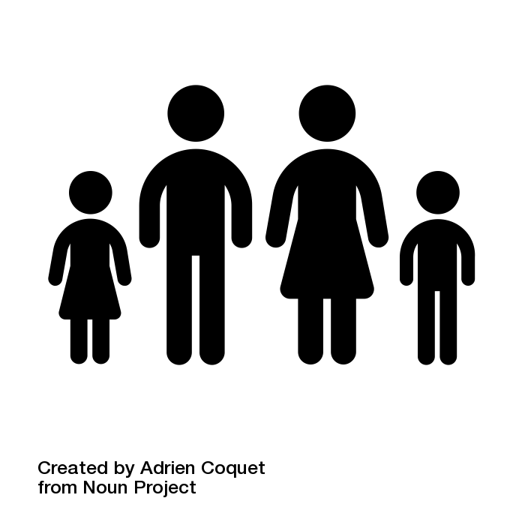
A POLICY INVOLVING CITIZENS AT DIFFERENT LEVELS

Slide 12
Children’s awareness
In order to make sure the new policy is properly put in place and really respected by everyone, we first need to make sure that the citizens fully understand the way the whole system is going to function. Second, we need to ensure a continuation of the functioning of the system. In this aim, we have decided that one of the key factors of a successful implementation of this new policy is to educate and inform kids and young people. The general idea is that workshops and projects are organised in schools and universities.
It is important to teach kids about the system if we want them to continue using it, and use it properly, so the workshops and projects will be implemented in the primary as well as high schools. But, in order to guarantee the quality of these methods, the people in charge of them will need to already be completely familiar with the whole idea. This is why we will first need to organise workshops for teachers and professors that will later manage the workshops and projects for their students. This will be done by our experts, and the start of the implementation in the educational environment should not be too postponed.
For elementary school students only workshops will be put in place. The reason is simply their age, they should not see at as something boring and too theoretical but rather as a fun and useful thing to do. The workshops should be interactive and with the aim of teaching kids about recycling in general to then concentrate more on the new system, and so in a playful way. And at the end of the process, a big competition could be organised.
Students from the same class would form a group and they would then first compete against other groups from their school. The first three places could then go to the higher level of the whole arrondissement where they would compete against the best groups from other schools. The game itself would follow the entire recycling process and the winner would be the team with the most correct sorting who would then receive an award (tickets to the cinema, bowling or something similar).
In high schools and universities, apart from the workshops which would take place at the beginning but much shorter than in elementary schools (so only 2-3 workshops, once a week), there will also be group projects organised.
The idea is to give students some technical knowledge about the new recycling system to then make them implement it. Their projects could deal with informing their friends from other arrondissements about the new policy, getting involved with some other projects and organisations with similar ideas, or simply assuring the policy is respected within their institution. For participating in such a project, they would obtain points (the credits used in the French educational system). In this way, not only will we educate young people from the 20th arrondissement, but will hopefully get to gradually spread the idea to students from other parts of Paris before introducing the same system is proven successful.
Lastly, students of all age, from the elementary school to the university level will get a chance to visit the sorting place. These visits will be organised after the workshops and after they have had a chance to first hear about it, and a small test will take place after the visit itself in order to make sure they have understood the process.

Slide 13
Caretakers training
Our project is based on a fundamental principle: the use of selective sorting bags by families. There are 4: Paper/Cardboard, Plastic, Glass/metal (like bottles/cans) and Other. In order to be able to inform the inhabitants of the project, we could initially organize a meeting between the managers of the sorting center (where the experiment is undertaking) and the concierges of each building. The purpose would be to explain in more detail the operation and the principle of the sorting center to the concierges. A test could be undertaking in order to show in a concrete way each of the key stages of the waste sorting center to the concierges.

Slide 14
Family / Citizens
Then workshops would be organized by the concierges with the representatives of the families of the buildings to explain the operation of the project.
Concierges would have a prerequisite training of one-day to give them the instructions of the meeting. They would receive cards with the different elements that they will have to be addressed during the workshop. The purpose of the concierges would be to explain the project, its importance and specify that it’s the 20th arrondissement that was chosen to experiment the project. This could arouse enthusiasm and interest by the inhabitants of the arrondissement.
During these workshops, they would concretely present the recyclable bags, and show the functioning of the application with the scan of the phone to know where each garbage depends on the garbage bag. They could let try the application for those who want it during the meeting to get a more concrete idea of how it works.
It would be mentioned during the workshop, that to control the good cooperation of the families and the respect of the sorting rules, fun alert messages will be sent to the families. The purpose is to inform them that they have made a mistake in their selective sorting and explain how this can be resolved.
The concierges would indicate that outings to the sorting centers will be organized to see live what happens to their waste and the need to properly sort their waste. All questions from the families can then be asked to the managers of the soring center. This would be a good way to make families aware of the importance of properly sorting these wastes into bags and encouraging their active participation.
Explanation cards on the operation of the app and it process of scanning the product to the destruction of the waste at the sorting center will also be distributed to each family.

Slide 15

BRING THE POPULATION TO RESPECT THE PUBLIC POLICY

Slide 16

INCENTIVES : A GLOBAL STIMULUS
As we discussed during the 10th session of the Great Transition class, governing Economic and Ecological Commons represents an intricate challenge. One of the many mistakes regarding the communication approach about protecting the human eco-system and therefore the environment is an alarmist strategy based on shocking advertising. If in essence the messages spread by the different organizations relying on the characteristics previously mentioned are true, the consequences might be distant to the targeted objective. In fact, it could and is, counterproductive as “promoting” the end of the world if people don’t take any actions might lead to a fatalistic approach. In other words, why people should make any effort as the world will inexorably end? Only taking into account the economic theory of maximization of satisfaction, shows that the different tools and choices made in the past 20 years might have been erroneous. According to the idea of which every subject wants to rise his satisfaction to its maximum, while keeping the costs of it reduced to a minimum, an approach by guilt and fear is not an appropriate path.
Lawrence W. Reed in his article “The role of incentive” published in the Foundation for Economic Education highlights the predominant role of economic incentives in society. If his work was published in 1982, the argumentation and reflexive path he had taken seems to be particularly assertive in our modern society. Reed affirms that incentives are an efficient compound that yields action if properly used. There are two intuitive and main rules regarding incentives. First, they must represent a high personal advantage or benefit. Secondly, those hypothetical benefits have to be obtained at a low personal cost. In other terms the bigger is the personal cost, the bigger the personal benefit impersonated by an incentive should be.
In our case, as it is a test for a further implementation of a policy, we assume that the personal cost of using the different tools and infrastructures we “created” is in a middle range of difficulty. Our incentive program will aim to promote environmental change and a responsible consideration of garbage waste and recycling. Therefore, we want to involve the different actors that compose the social ecosystem:
· The State:
The state must be the main actor as much on the infrastructures as the finances that will allow to develop the project. The role embraced by the state entity is also to ensure major incentives as a stimulus for the test families. There are various elements on which the incentive could be bases. One of the idea we had are on discounts for the pass Navigo, taxes or in general public infrastructures. As in general citizens use state equipment on a daily bases it could be a path to explore.
· The companies:
According to our communication and marketing classes, we realized the importance of environmental compromise as a major key point of a brand opinion amongst its users and subjects. Major companies have adapted their communication strategies to match with the expectation of the civil society. A trivial, but nevertheless true, example is how McDonald payed a very careful attention to the subject previously mentioned. Taking into consideration those factors we think that giving a chance to companies to offer incentives on their products/services could be considered as a win-win relationship for both companies and citizens.
As a conclusion on the incentive program itself, we think that an inclusive approach of the State and private companies could be a very profitable item for our project. In fact, for companies it would provide a certain visibility amongst citizens and also positively impact their brand image as being involved in recycling. On the other hand, a various panel of incentives, practical ones as the Navigo pass discount or on groceries, but also more “trivial” ones would allow to touch a major part of the population interests. Another great impact is a collaboration between 3 major actors of today’s societies, allowing to create a responsible and successful policy. Those incentives would be available on the application with the ability to “purchase” them through a system of points.

Slide 17



THE POINT SYSTEM : A LUDIC AND PRACTICAL SYSTEM
To create a realistic point system, we tried to contact the different conceptors of the applications that already exists (listed beneath). Unfortunately we never got an answer and we had to think our own system. We first thought of using statistic data available in the Insee data base. In fact, the average amount of waste produced by families in France is available, but we think of including other factors. Since we want to implement a policy that will rely on “test families” we would take advantage of the data we will collect from them to create a caption including the average waste production depending on the number and age of family members. We are perfectly conscious that our system might not be perfect but with a professional insight we are sure it could be possible. As our recycling centers are going to be equipped with a certain amount of technology we hope to be able to measure the average waste weight for each of those families. The amount of points caption is going to be elaborated with a dialogue between us and the different companies that want to be involved in the project.
The points are going to be distributed according to that weight and the personal starting ratio. Every improvement will be rewarded with a certain amount of points. We also think that points should be granted every 2 months as a way of developing loyalty amongst our users. Those point would not only allow users to be able to “purchase” incentives but a monthly ranking would be available on the application. This measure aims to create a sane competition between the families as a nudge, potentially yielding more implication from those families.
On a behavioral level, we are sure that a point system would not only allow use to keep a reliable tracking of the families, as we will have reference captions, but also to incentive psychologically the users. Indeed, the points would give the feeling to the users that they are achieving a goal besides the benefits they could obtain from the incentives available on the application. This point system is more than anything a self-empowerment factor, which will without a doubt have a positive effect on the efficiency of our measure.

Slide 18
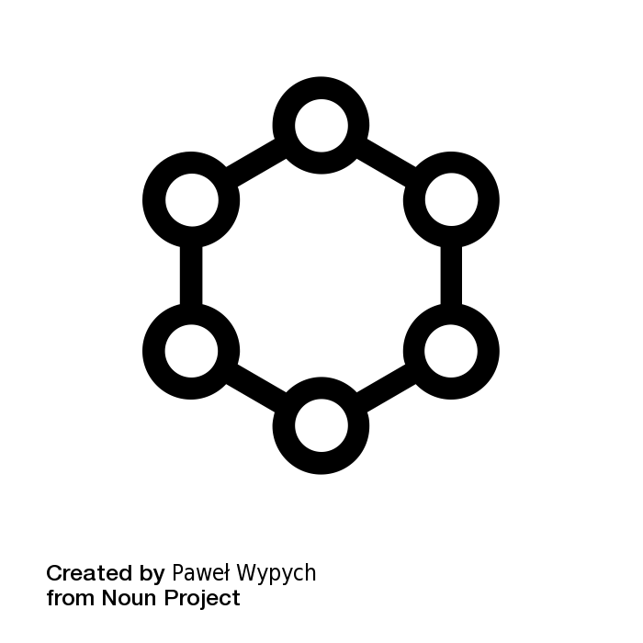
NUDGE SYSTEM
In order to support our public policy, we would like to introduce a system of nudges : our individual decisions are influenced by the context, our automatisms and our subconscious and nudges are exploiting those influences by mixing behavioral science and economics. We are here living the prism of costs/benefits, which would normally matter in the decision-making : here we consider that our choices also take into account our emotions, social norms and environment. We want to enlighten the benefits of recycling, in order to make people more willing to use our system, without giving only monetary incentives.

Slide 19
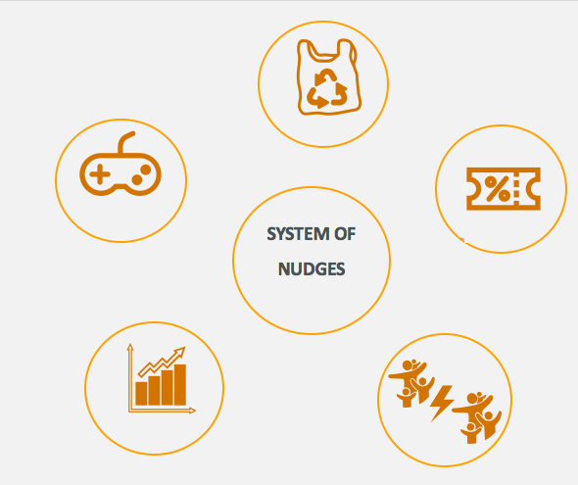
SEVERAL NUDGES HAVE BEEN CONSIDERED IN ORDER TO IMPROVE RECYCLING RATE
The plastic bag could be transparent so everybody will be able to see if the other are recycling or if they are wasting a lot of food for example. It could encourage people to waste less, because they would be afraid of the perception of others. It has already been successfully implemented in other countries such as Germany.
Concerning the app, people could have access to little games if they enter additional data into the app, so they can play a game and have a chance to win a voucher.
A monthly contest between the family of the neighborhood : a list of the top-ten families would be displayed on strategic points of the neighborhood (shops, schools). For this measure, the center could its data to determine which family is the best, based on the recycling rate and the most minimal number of mistakes. It would require that the center keep cracks of the messages send to the families (to evaluate the number of mistakes) and the number of bins collected (each time a bin is scanned). It would create a friendly competition who will motivate the families
Besides the messages for the misrecycling, we could send friendly messages to the ones who recycle well and give them a grade and an analysis of what they missorted : they could see what they can improve. We could also have a charter in the app to see the progress

Slide 20

TECHNICAL ASPECTS OF THE POLICY

Slide 21
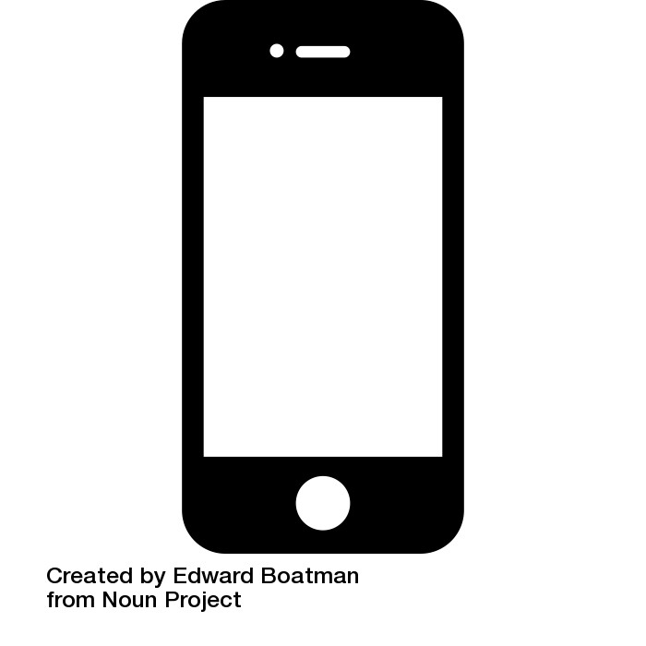
The mobile application
Our app is at the heart of the policy, being both the link between users and the sorting center and the tool improving the recycling process. It targets all the members of the family from the parents to the little kids, that is why it can be installed on several devices such as the father’s smartphone and the family’s digital tablet, with one single account for the whole household. Thanks to this very user-friendly app, everyone is involved in this project and learns how to properly manage their waste - this is key for the success of the policy. To this end, we have imagined a very clear and simple design, so that each member of the family can use the app without any difficulty on a daily basis. Thus, there are four main features we can directly access on the home page: the barcode scanner, the family data, the main information about the sorting center and the frequently asked questions.
The barcode scanner is the very essence of our app. It allows the user to exactly know how to recycle each part of any product. When someone is not sure which bin has to be used, he scans the barcode of the merchandise and the app immediately tells him how to sort it out. We want this process to be as efficiently as possible thanks to the use of colours which correspond to the ones of the different bins. This system is very simple and is based on a complete and powerful database which gathers all the products that can be found in the neighbourhood. There is a significant work of creating this database before the policy is concretely implemented. For new products that wouldn’t yet be identified, each user is asked to describe its contents and to propose a sorting process. We, the policymakers, are in charge of verifying and accepting this proposition, as well as integrating this product in the database.
The family account page on the app allows households to have access to all their data regarding the quantity of waste they have produced during a week, a month or a year. They can also compare their personal results with the ones of other families, giving them incentives to consume products which produce less waste. The center also gives them feedbacks about the quality of their sorting (e.g.: 95% of your waste was in the correct bin), and also tools and tips to improve their recycling process. The app is really the intermediary between users and the sorting center. On the information tab, families can find the opening hours of the center and can also directly interact with it when they have questions about precise points or when they need new trash bags. Each family receives a specific quantity of bags for a certain period. They are all personalised with a barcode which corresponds to a particular household in order to control the sorting of each user. However, there will be occasions were more waste is generated, for instance if the family in question organizes a party or purchases equipment goods. This is where the possibility to order additional personalised trash bags comes in handy.
Ultimately, the last tab consists of a comprehensive list of Frequently Asked Questions (FAQ) where users can find tips to be more efficient in their sorting process.

Slide 22

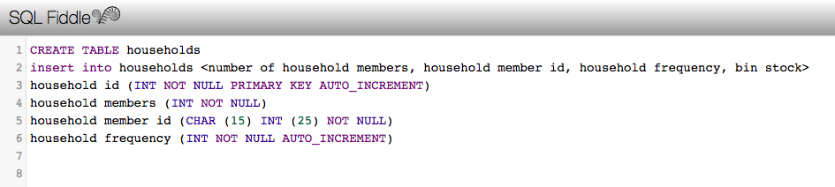
Technical Features
In order for the recycling process through our app to operate optimally, it is of paramount importance that the database managed and updated in an efficient, sustainable manner. A suboptimal or faulty database will effectively cripple this project.
The database has two fundamental pillars:
a. User data (family statistics), linked to each household’s account.
b. The recyclable waste data
The part of the database dealing with user data is fairly straightforward. The principal task at hand revolves around registering key information on the household in question, its members and ultimately their recycling habits. Using Microsoft MySQL, the first step of registering household information is done by creating a table with the following fields:
Household ID (will exclusively consist of integers and will be randomly generated upon designation of an ID to a household) e.g. Household Name (field to be linked to the App or the site,
Number of household members
Household Member ID
Household Frequency (each time a member recycles)
Bin stock
Thereafter, we will proceed to the second pillar of the database - the potentially infinite field that houses the information on the actual recyclable products. We must note that it is almost impossible to create a complete version of such a database, given the vast product diversity that characterises the French market. However, this challenge represents an opportunity to increase user engagement with our app, as you shall see in the following paragraphs. The seemingly mammoth task of collecting information on the recyclable products can be broken down into manageable tasks, and with the collaboration of all stakeholders the sustainability of this continual task will be guaranteed. By breaking down the initial collection process into three strands, we will be able to to amass up to 90% of all products in the XXe arrondissement upon launching the app. Once the first strand has been completed, the app will be launched and the second and third phases can be initiated simultaneously. This database will use a model similar to that of a wholesale inventory database and we will use Microsoft mySQL.
Above is an example of how the aforementioned concept can be programmed into a database using Microsoft mySQL. The following commands used ensure:
INT : the field must consist of integers
NOT NULL : field cannot be left blank
CHAR : field consists of characters (e.g. CHAR (25) → 25 character limit
PRIMARY KEY : This distinguished the table’s key field
AUTO INCREMENT : increasing numbers
We will then be able to extract important data from these fields such as the estimated gross mass recycled per household over certain time periods, household member participation (e.g. best-performing recyclers, number of new products submitted (and accepted) to database. The bin stock field will keep an inventory of the household’s recyclable waste bag stock, and will alert all users when it will be convenient to order new recyclable bags (barcoded to household account). We can also use this information to help estimate orders for specific events e.g. parties; garage-clean out etc.

Slide 23
Strand 1: Pre-Launch Phase
Engage local distributors (supermarkets of all sizes, epiceries, etc.) and register all their products.
Registering procedure entails saving, the (1) barcode, (2) name, (3) estimated weight of all recyclable components, (4) the recycle bin destination of each component. e.g. glass jar of confiture : lid (8g)—> yellow (tins) ; jar (140g)—> blue (glass) etc. This phase is to be completed before the app launch so as to ensure a considerably large database for our very first users.
Strand 3: Manufacturer engagement
This phase of the database updating goes further than the preceding strands because here, we will engage manufacturers of recyclable goods made in France, and ask them to submit to us the barcodes with the information we require (nature of components, estimated weight of components). New product information will be readily available, making the app easier to use. We foresee this strand to be particularly successful as we anticipate companies to be enthusiastic about the potential marketing and brand promotion benefits their brands/products could potentially benefit from through using our app and the association of these brands and products with the ecological cause.
The above methods and practices will not be complete, exhaustive lists of the available products found and used in the XXr arrondissement. However, they will ensure a comprehensive database is available that will not demotivate users, but rather encourage them to use our app.
In order to allow users to exactly know how they have to sort each product, there should be a scanner inside our app. As we use the ASP.NET software to create the app, we need to integrate a barcode scanner that works with this system. Since this type of scanners already exists, we choose one of them, considering our specific requirements. First, we consider linear barcodes (the ones that are on all the products sold in supermarkets) and 2D barcodes (such as QR codes), so that it is possible to scan any existing barcodes. Then, after having studied all the 21 different possibilities, we decide to pick the most popular, the most efficient and the easiest to use: ASP.NET Code 39 Reader & Scanner SDK. This software scans and reads all the existing linear barcodes such as the EAN-13 (European Article Number with thirteen digits), the EAN-8, the EAN-5, the Code 39, the Code 49 or the Code 128, and various 2D barcodes such as the QR code from different sources. Finally, we have to purchase the license to be able to use it. It is costly but necessary: the Linear + 2D package price is at $1,590.
Strand 2: User engagement phase
As previously mentioned, the app will allow users to upload products that are not on the database, upon the non-recognition of a barcode. The app will advise users to refer to stickers on the product for weight estimates of the packaging, suggesting easy weight estimation methods. Then, they will be required to take an entire photo of the product, and suggest destination colours for each component. This will be submitted to our database management team who will quickly validate the product. In order for this method of updating to be successful, we suggest including small financial incentives to users for every new product submitted to the database.

